Slide 1

Traffic Volume Analysis of I-94 Westbound between Minneapolis-St.Paul, Minnesota
Team Members:
Tony Wilson, Rajeev Daithankar,
Matthew Harper, Anand Punwani
AI Boot Camp Project 1

Slide 2
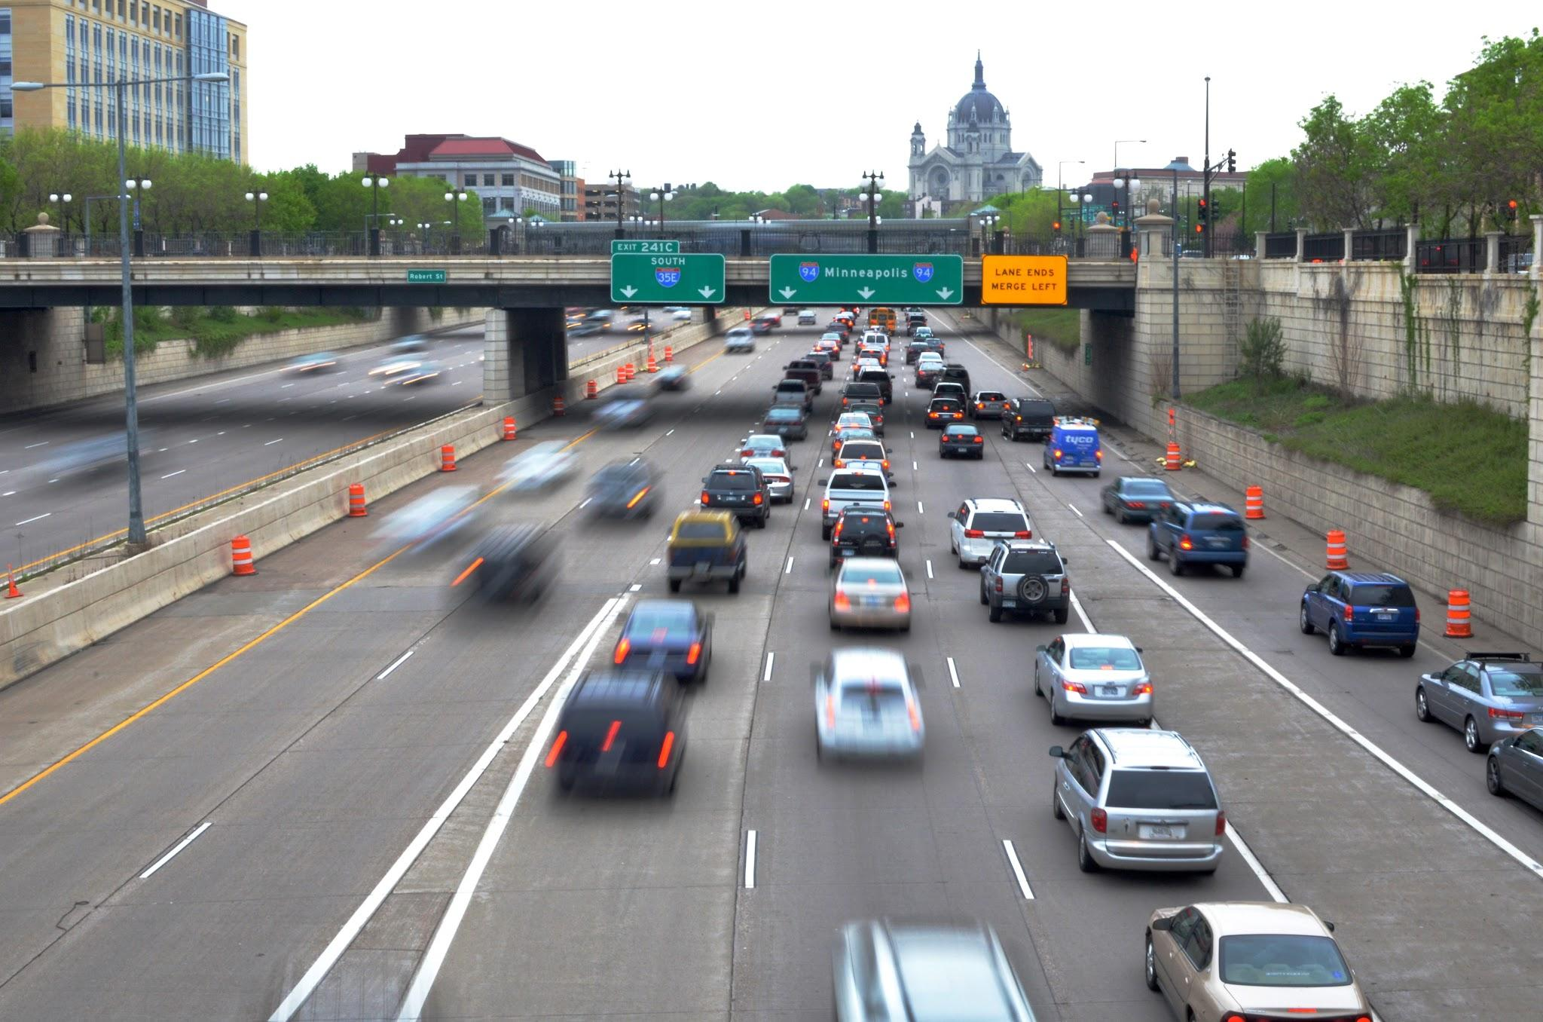

Project Purpose / Description
This project will analyze a series of data points collected from the West Bound lane of I-94 in the Minneapolis-St Paul, MN area between 2012 and 2018. This data was collected on an hourly basis and includes the following:
Traffic Volume
Temperature
Rainfall
Snowfall
Percentage of Cloud cover
Holidays
and much much more!!
This project will analyze that data to evaluate correlations between the traffic volume and the other various data points.
Goals to be addressed
Determine impact of holidays on traffic volume
Determine impact of rain on traffic volume
Determine impact of snow on traffic volume
Determine impact of clouds on traffic volume
Determine impact of temperature on traffic volume
Notes:
To achieve our goals of finding what was the biggest impact to traffic volume, we have taken the data from I-94 Westbound between Minneapolis-St.Paul, MN and broken it down by, if it either was or was not a holiday, and by the different types of weather conditions. The broken down data was then used to find correlation between the traffic volume and the variables to determine both, if there was any strong correlation to any variables, and if not then what variable has the highest correlation.

Slide 3
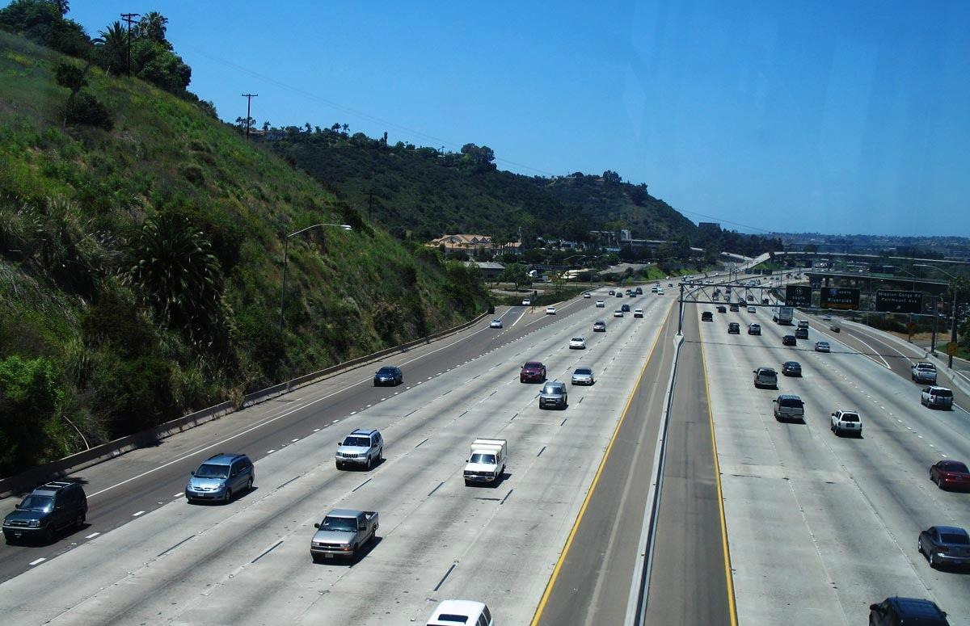

Data Exploration
What is Data Exploration?
The data exploration is done to gain understanding / insight about the selected data
Typical steps involved are
Understanding of variables of the dataset, number of rows, columns, data types.
Identifying missing values, duplicates, outliers and handling them.
Understanding of Central tendency(Statistics), Mean, Mode, Median and dispersion, distribution.
Identifying pattern, trends and relationships in data through visualization techniques such as histograms, scatter plots and heatmaps.

Slide 4
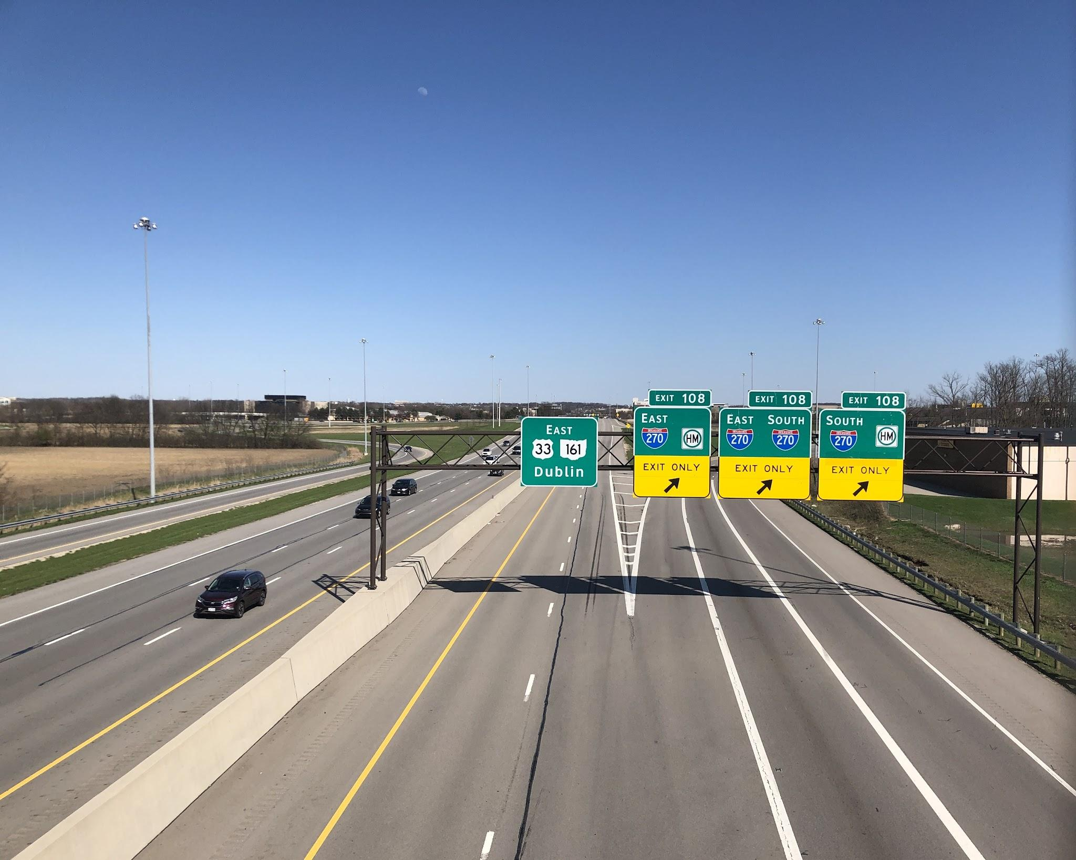

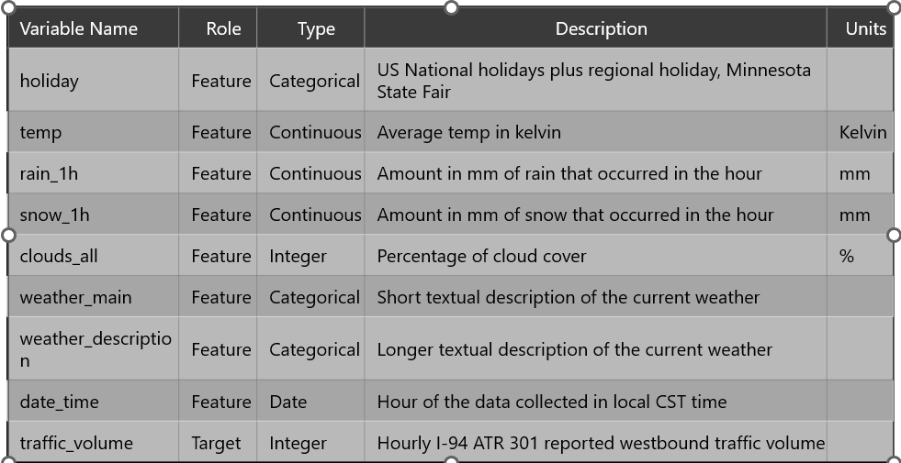
Data Collection
Data Source : UC Irvine Machine Learning Repository
https://archive.ics.uci.edu/dataset/492/metro+interstate+traffic+volume
Understanding Data

Slide 5

Data Cleanup
Identifying and Handling missing values:
Holiday values are present only at 00:00 hour of the date, missing at other hours for the date. Created a program to fill in missing holidays.
Missing hour sequences for a particular date. To handle this, data can be manufactured.
Pros and Cons of manufacturing data to fill in missing data
Pros: Completeness, Preserves structure
Cons: Not real data, leading to bias, Incorrect results.
We have decided not use manufactured data for this assignment, in order avoid biased results
Checking Duplicates:
Found duplicates for date_time and traffic volume combination. Removed these duplicates.
holiday | date_time
Columbus Day | 10/8/2012 0:00
None | 10/8/2012 1:00
None | 10/8/2012 2:00
Original Seq. | Missing Seq.
9/21/2017 9:00
9/21/2017 13:00 | 9/21/2017 10:00
9/21/2017 14:00 | 9/21/2017 11:00
9/21/2017 15:00 | 9/21/2017 12:00
holiday | date_time
Columbus Day | 10/8/2012 0:00
Columbus Day | 10/8/2012 1:00
Columbus Day | 10/8/2012 2:00
temp | weather_main | weather_description | date_time | traffic_volume
59 | clear | sky is clear | 9/21/2017 10:00 | 2500
59 | clear | sky is clear | 9/21/2017 11:00 | 2500
59 | clear | sky is clear | 9/21/2017 12:00 | 2500

Slide 6

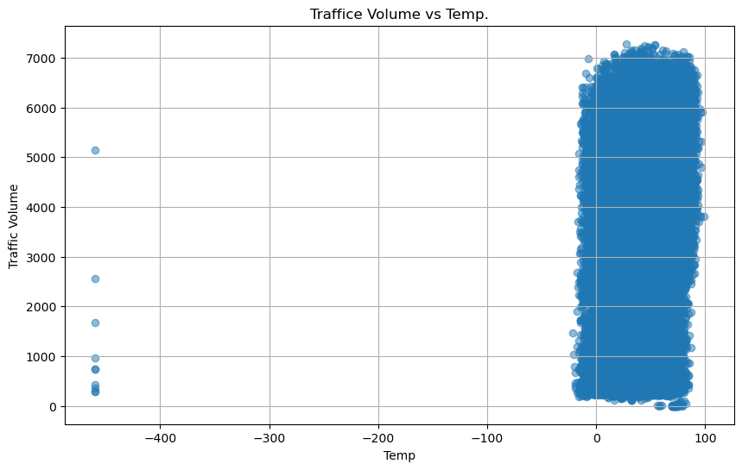
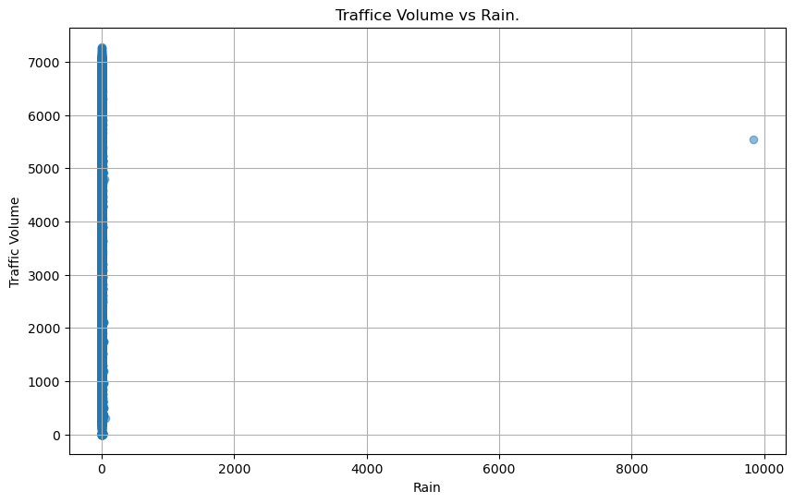
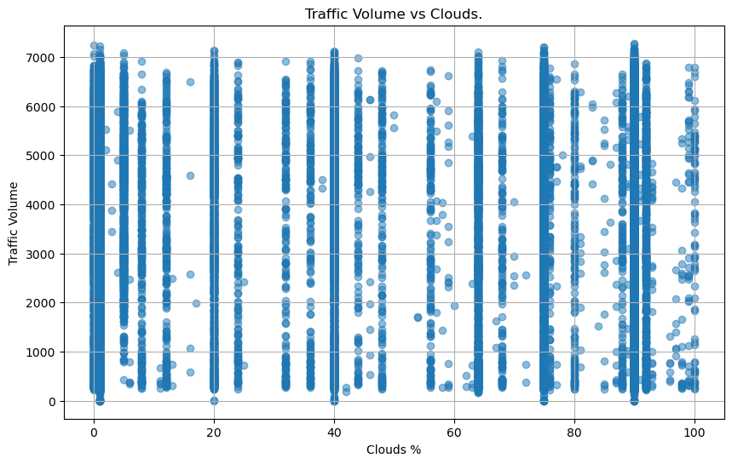
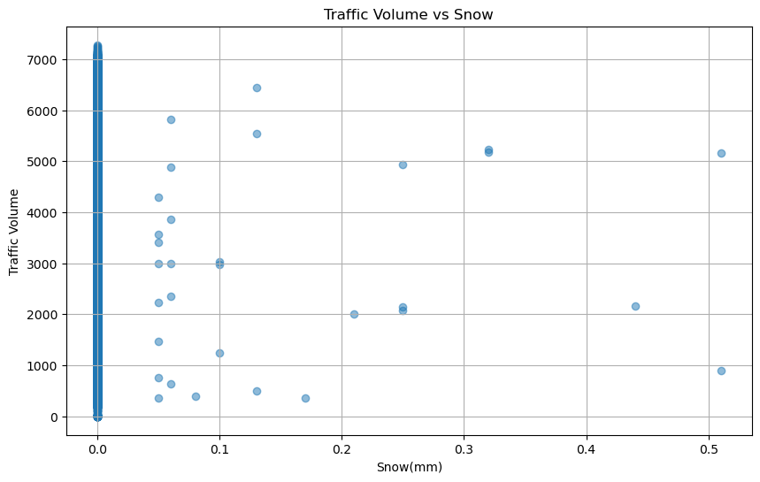
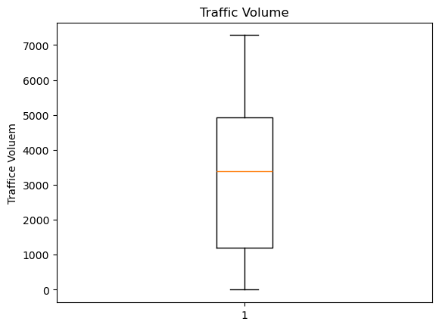
Data Cleanup
Identifying and removing outliers:
With the help of scatter plots we found that there are outliers in variables Temp,Rain
Removed outliers : rain <407 mm and temp temp > -50 Deg. F (converted temp Kelvin to Fahrenheit)
No outliers for Cloud % and Snow mm
Box plot for Traffic Volume - No outliers for traffic volume
Q1: 1194.0, Q3 : 4933.0. IQR: 3739.0
Values below -4414.5 could be outliers , Values above 10541.5 could be outliers..

Slide 7
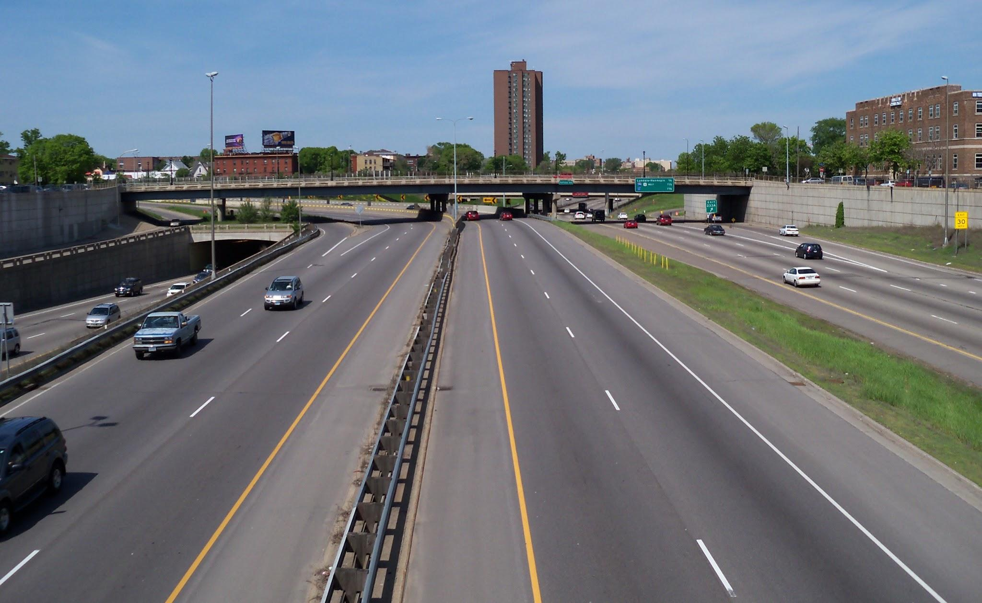

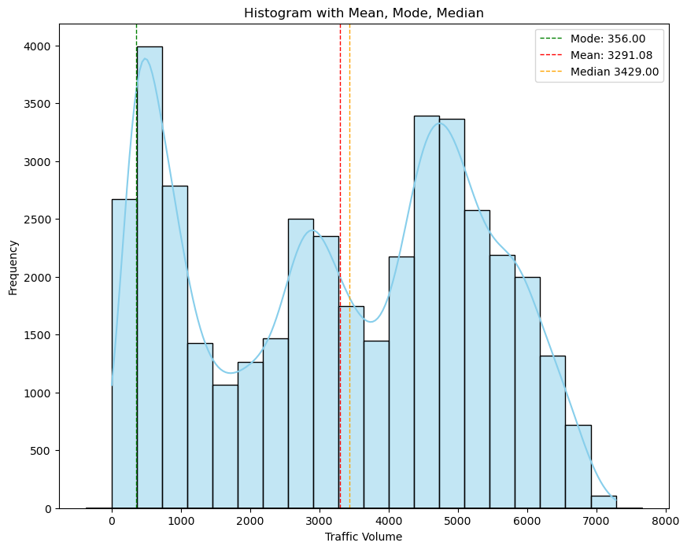
Data Exploration
Central Tendency
Mean, Mode, Median of traffic_volume
Mean: 3291.08, Median: 3429.00 Mode: 356, count=40
For this dataset
The mode is significantly lower than both the mean and median, indicating that there is a peak towards lower end of distribution.
In this case, the distribution is negatively skewed (mean is less than median).This means that the tail of the distribution extends towards lower values, while bulk of data is concentrated towards higher values.
Notes:
**Central Tendency**
Central tendency is defined as “the statistical measure that identifies a single value as representative of an entire distribution. It aims to provide an accurate description of the entire data. It is the single value that is most typical/representative of the collected data.
It lets us know what is normal or 'average' for a set of data. It also condenses the data set down to one representative value, which is useful when you are working with large amounts of data.
Mode: The mode is the most frequently occurring value in the dataset
Median : The median of a dataset is the value that’s exactly in the middle when it is ordered from low to high.
Median of an odd-numbered dataset
For an odd-numbered dataset, find the value that lies at the (n+1)/2 position, where n is the number of values in the dataset.
Median of an even-numbered dataset
For an even-numbered dataset, find the two values in the middle of the dataset: the values at the n/2 and n/2+1 positions. Then, find their mean.
Mean: The arithmetic mean of a dataset (which is different from the geometric mean) is the sum of all values divided by the total number of values.

Slide 8
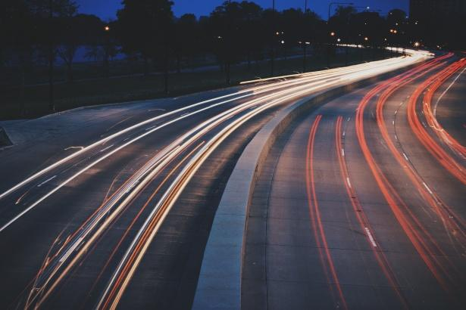

Data Exploration
Measures of Dispersion
Range, Variance, Standard Deviation, Interquartile Range (IQR)
The range of Traffic Volume is : 7280
The population variance is : 3938694.26
The population standard deviation is : 1984.61
Mean and Std. Deviation
Mean of traffic volume is 3291.08 (SD=1984.61)
SD of 1984.61 indicates how much variation there is from mean 3291.08
Interpretation:
1. Large SD indicates that data points are spread out widely around mean.
2. Mean is greater than SD, implies that there is significant variability or dispersion in dataset, with data points scattered over a wide range.

Slide 9
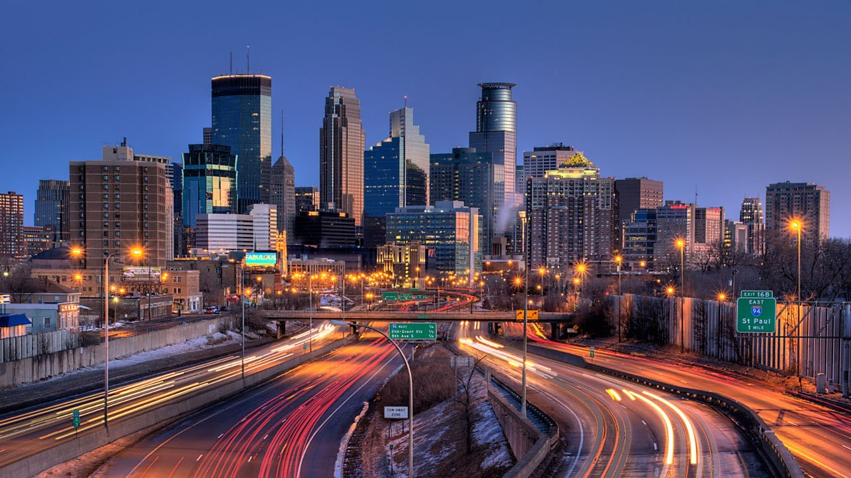
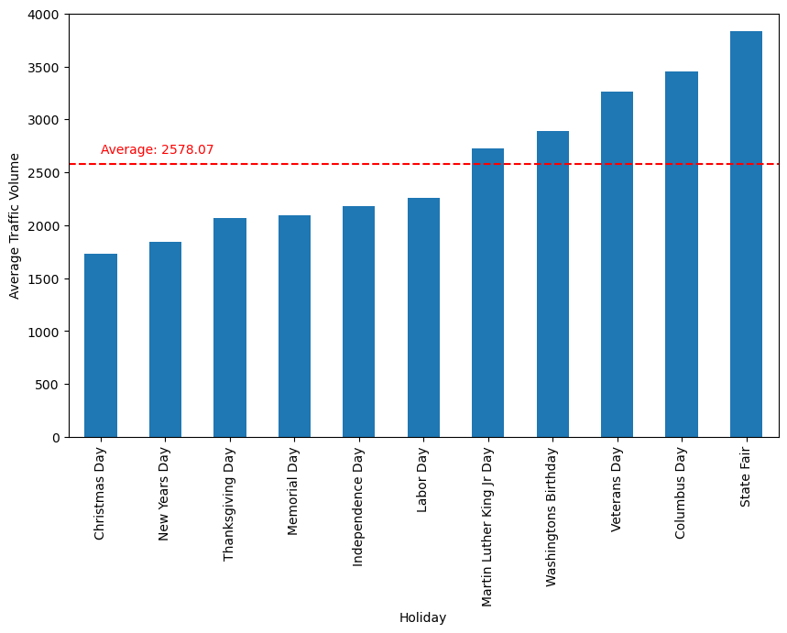
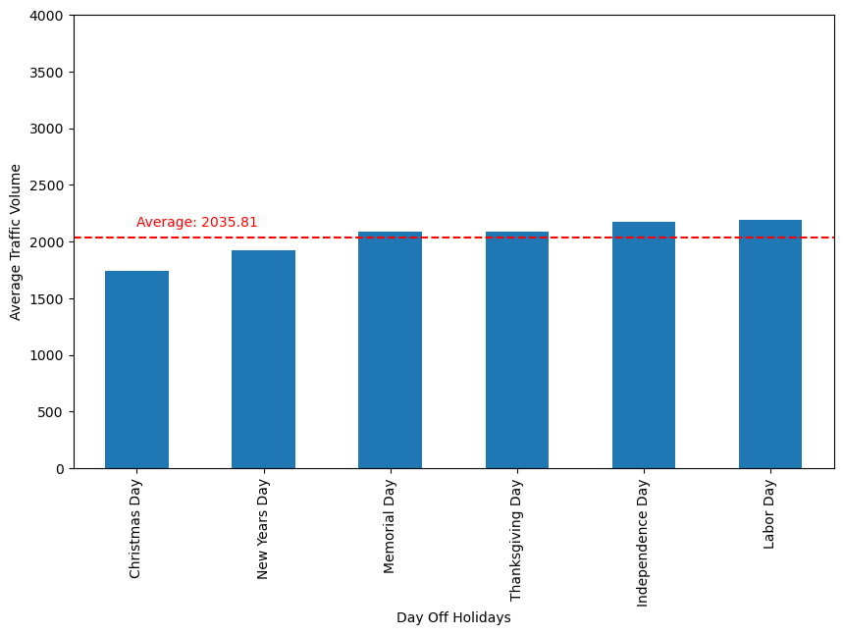






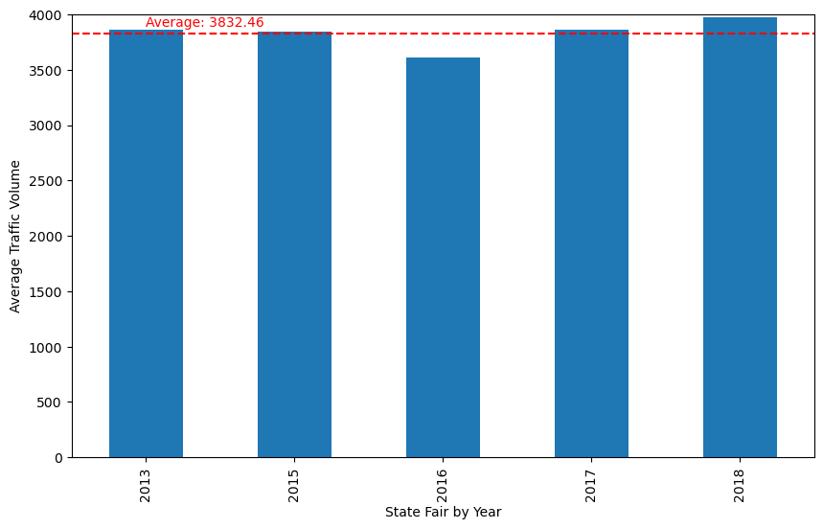
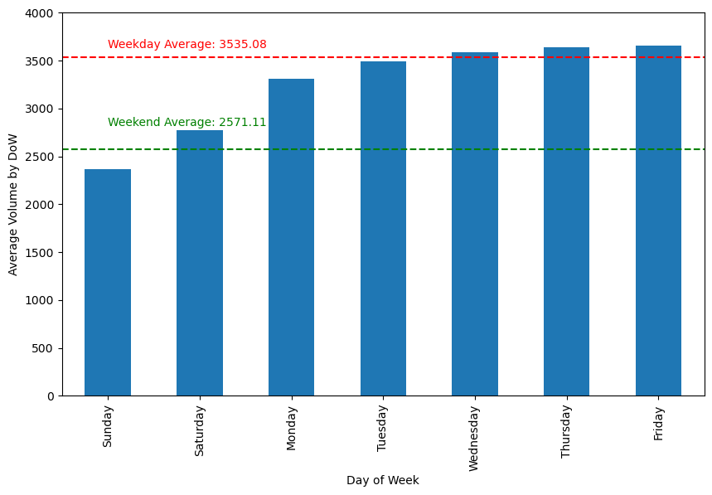
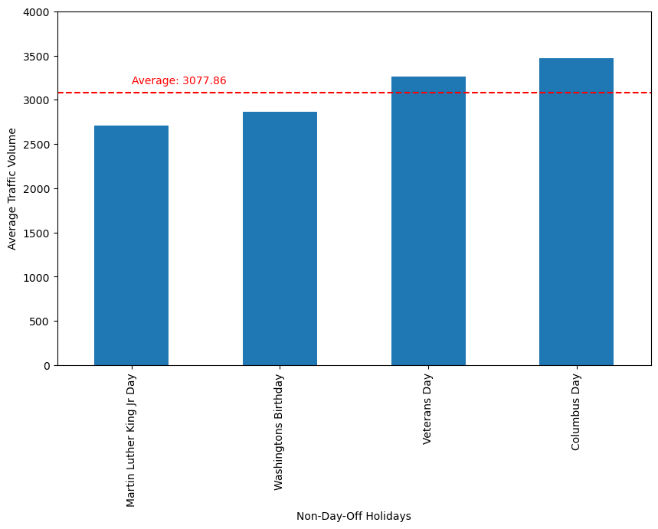

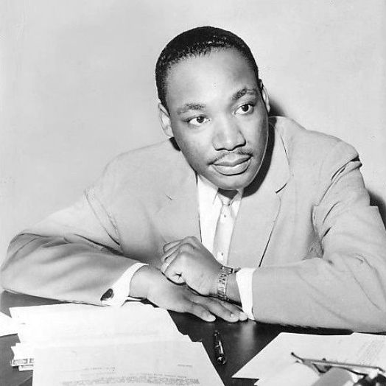



The Holiday Impact
Exploring the impact of holidays on traffic volume as compared to average (non-holiday) days of the week.
Notes:
Analysis: - We calculated the average traffic volume for each holiday in each year.
- We calculated the average traffic volume for each day of the week.
Visualization:
- We created bar plots to visualize:
- The overall average traffic volume for each holiday.
- The average traffic volume for each day of the week.
- We ensured that all plots had the same y-axis limits for easier comparison.
- We sorted the plots by either holiday names or traffic volume values, as desired.
Next Steps:
- Further analysis could involve exploring trends over time, seasonality, or correlations between different variables in the dataset.
- More advanced visualizations or statistical analyses could provide deeper insights into traffic patterns and behavior.

Slide 10
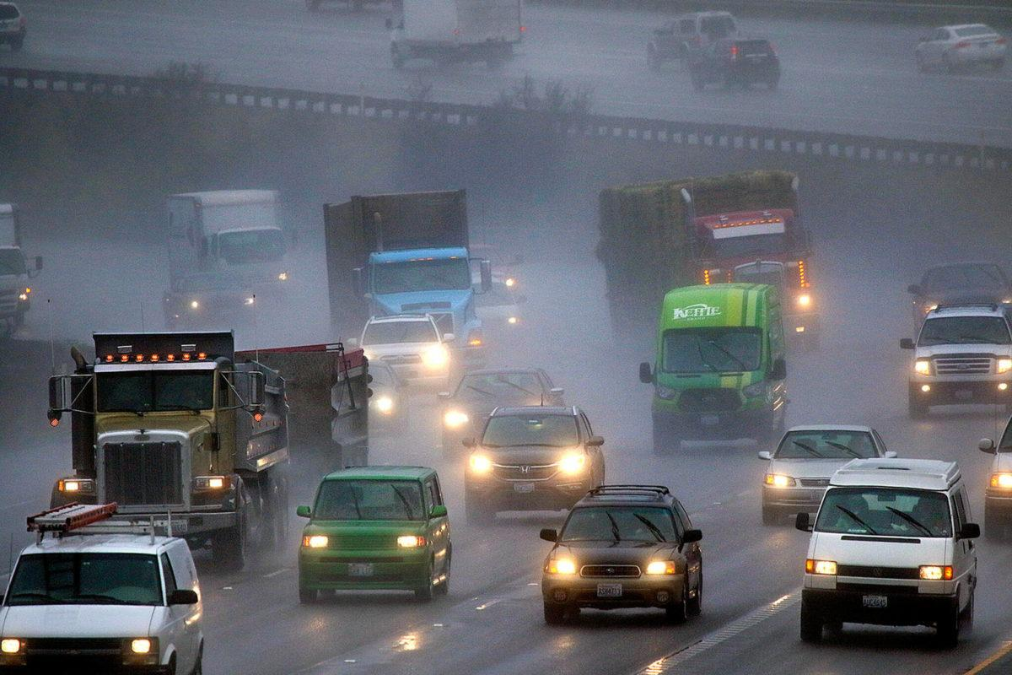
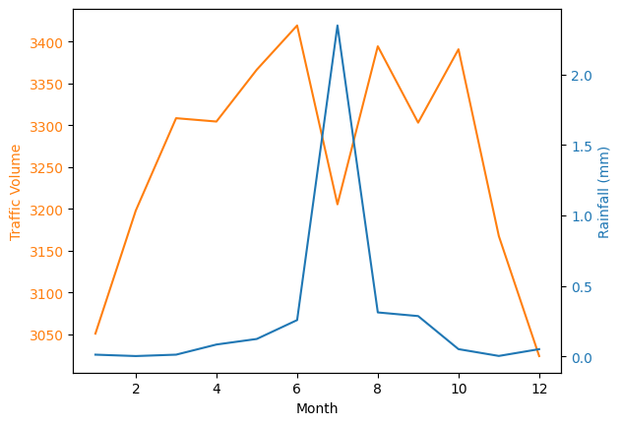
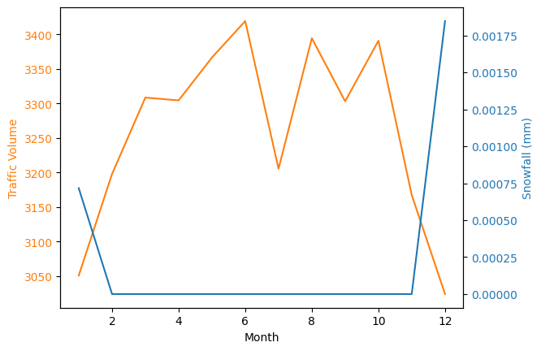
Precipitation Impact
Monthly Average Hourly Traffic Volume graphed against Monthly Average Hourly Rainfall and Snowfall
There is a very slight negative correlation between traffic volume and rainfall (-0.01)
Most noticeable around July although this could be for a number of reasons (construction/vacations)
Virtually no correlation between traffic volume and snowfall (0.00)

Slide 11
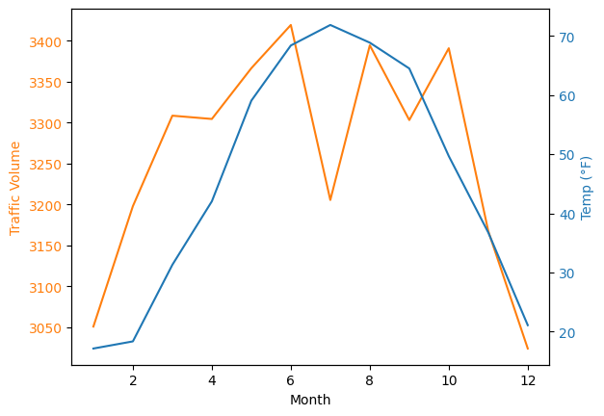
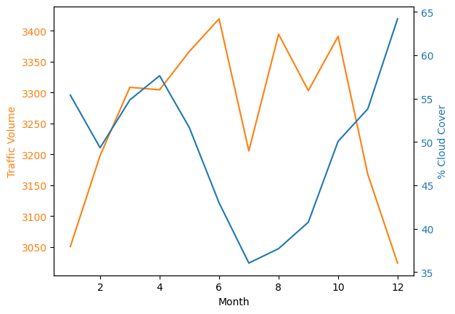
Temperature & Cloud Cover Impact
Monthly Average Hourly Traffic Volume graphed against Monthly Average Hourly Temperature
This was our strongest correlation (0.14) but still very weak.
Monthly Average Hourly Traffic Volume graphed against Monthly Average Hourly Cloud Cover
Correlation was .08 which again suggests very little correlation

Slide 12
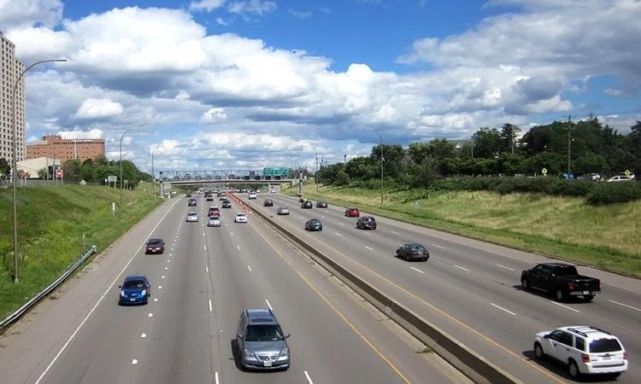
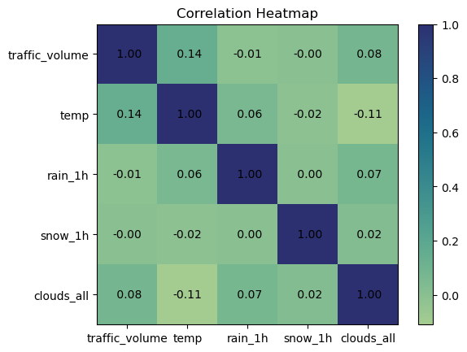
What is the correlation between variables and increased traffic volume?
There have been two types of variables given, whether it was a holiday, or whether there were weather based variables.
Based on the data, National holidays do not show a strong enough correlation overall to provide much towards the increase or decrease of traffic volume. The holiday data does show that there may be some other cause during these times to influence the traffic volume based on the specific holiday
Overall the temperature itself had a higher correlation to traffic volume over any specific weather condition but was still not high enough to be a strong correlation and thus suggests other reasons as to why they seem to correlate.

Slide 13
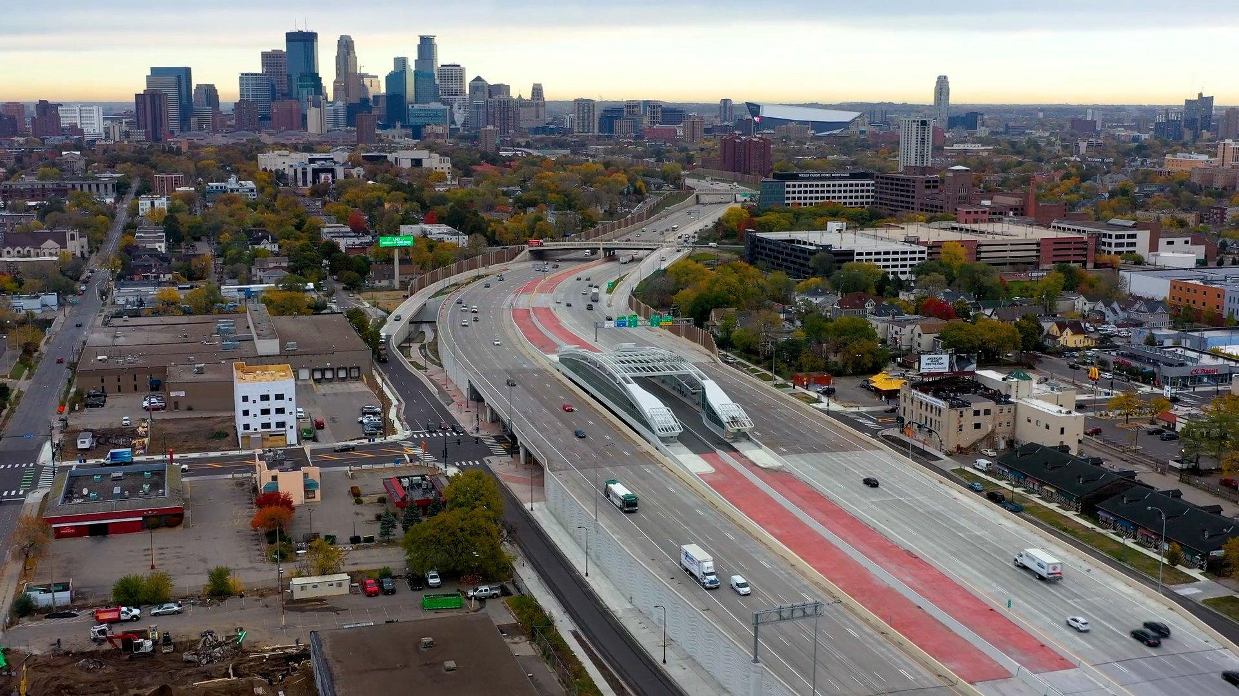
First: Based on our analysis of the data there is no strong correlation between the weather and whether or not the traffic volume increases. Any correlation between weather based variables must be due to other circumstances such as job attendance and similar.
Summary
Second: Based on our analysis of the data, although there is no strong correlation between there being a national holiday and the traffic volume increasing, what is apparent is that depending on how a national holiday is viewed and their general practices, traffic volume will raise or lower from the median accordingly

Slide 14
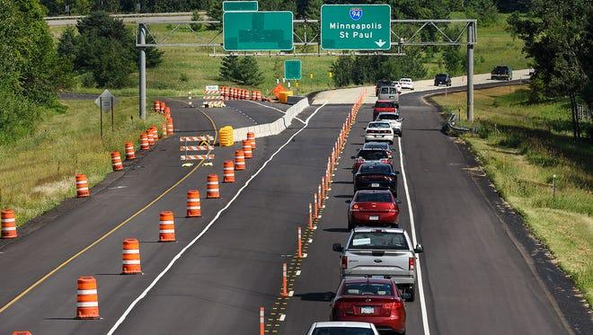
1. Use of Seaborn library to plot histogram for correlation matrix. All values for correlation matrix are not displayed in cell.
Resolution: Instead of Seaborn, used matplotlib and it worked.
2. Data had rows with duplicate date_times but other differing data which caused certain data to receive duplicate values which may have skewed the data slightly.
Problems Encountered

Slide 15
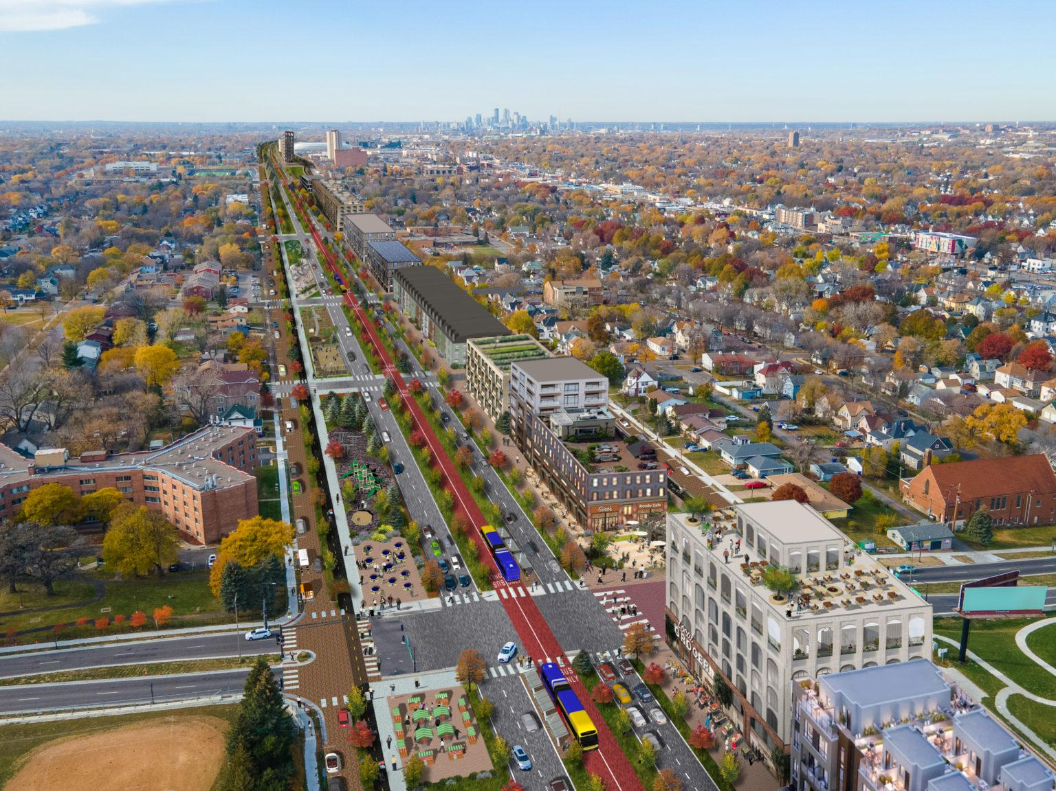

Questions for Future Development
If the data would be available, we believe it would be interesting to look at the same data but during the COVID lockdowns, to see if the same trends showed up even with the decrease in traffic volume. In the same vein it would be interesting to look at other roadways traffic volume data to compare and see if the same trends appear in different areas of the United States
As an additional inquiry, we would like to find the data for the year after our data ends and test it against a Prophet forecast to see how current events may affect the true data vs the prediction
Future Considerations

